Slide 1
MAGNETIC FORCES, MATERIALS AND INDUCTANCE

Slide 2
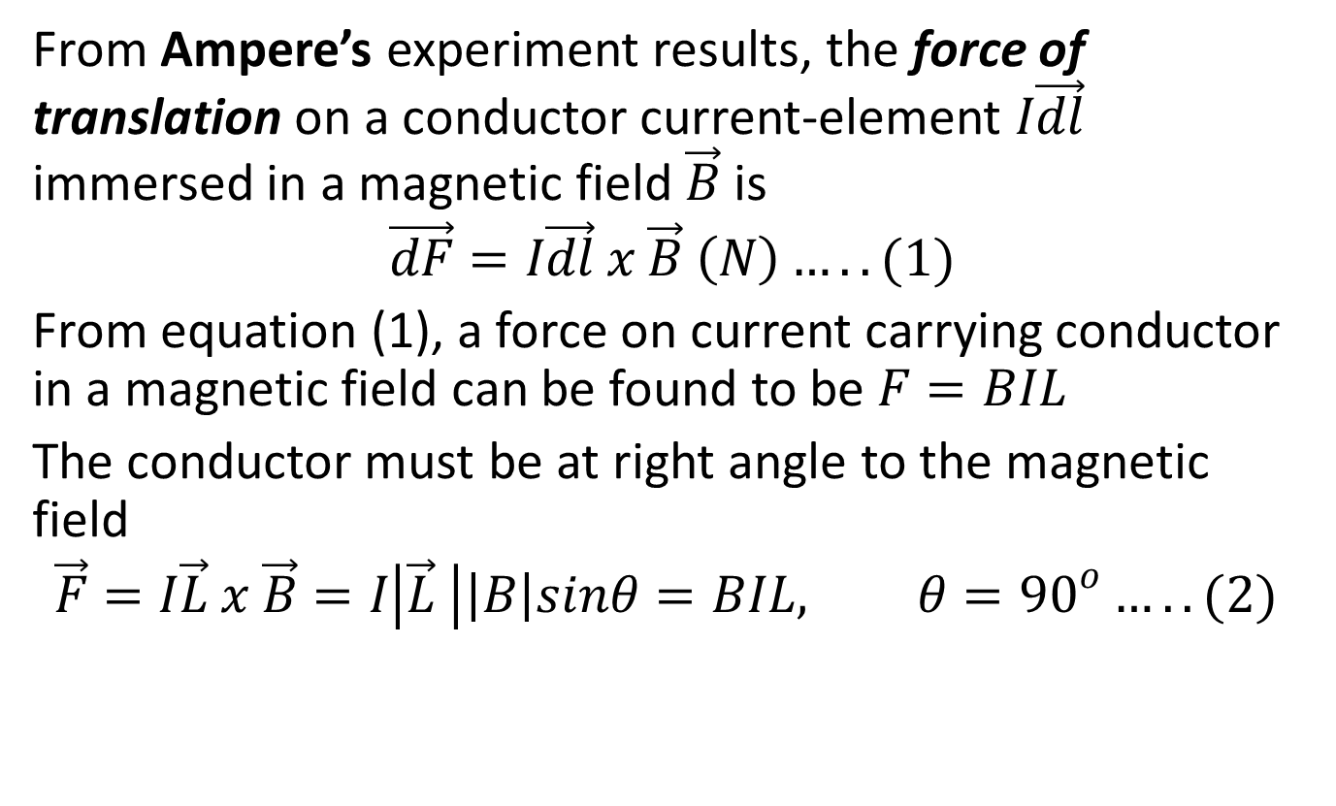
FORCE BETWEEN CURRENT ELEMENTS
From Ampere’s experiment results, the force of translation on a conductor current-element $I\vec{dl}$ immersed in a magnetic field $\vec{B}$ is
$$\vec{dF}=I\vec{dl} x \vec{B} \left(N\right)…..(1)$$
From equation (1), a force on current carrying conductor in a magnetic field can be found to be $F=BIL$
The conductor must be at right angle to the magnetic field
$$\vec{F}=I\vec{L} x \vec{B}=I\left|\vec{L} \right|\left|B\right|sinθ=BIL, θ={90}^{o}…..(2)$$

Slide 3
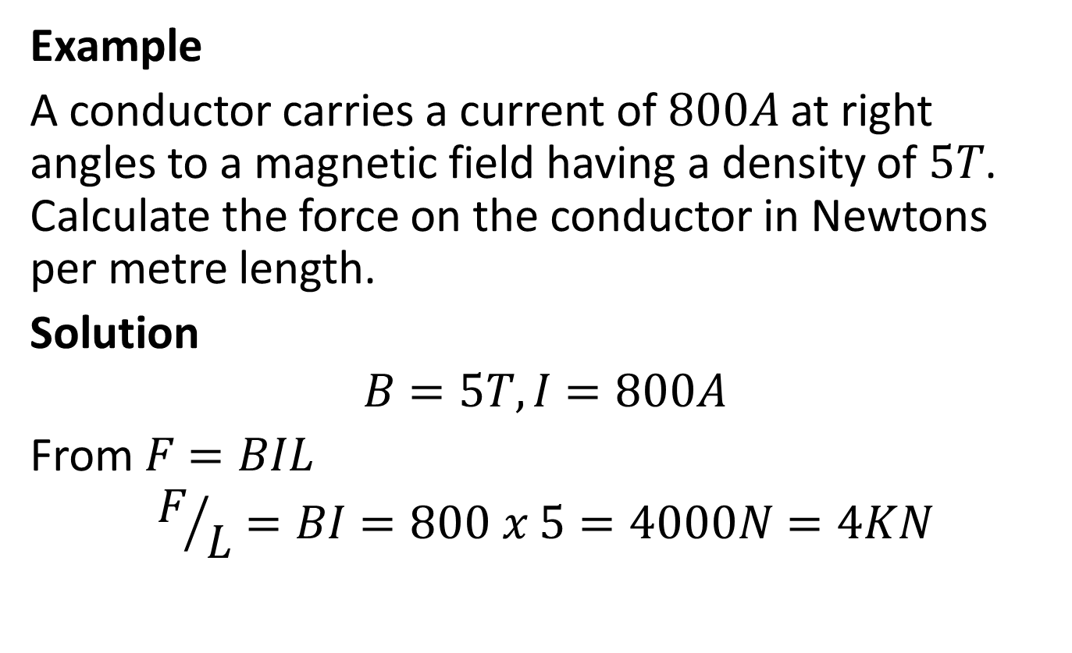
Example
A conductor carries a current of $800A$ at right angles to a magnetic field having a density of $5T$. Calculate the force on the conductor in Newtons per metre length.
Solution
$$B=5T, I=800A$$
From $F=BIL$
$$F/L=BI=800 x 5=4000N=4KN$$

Slide 4
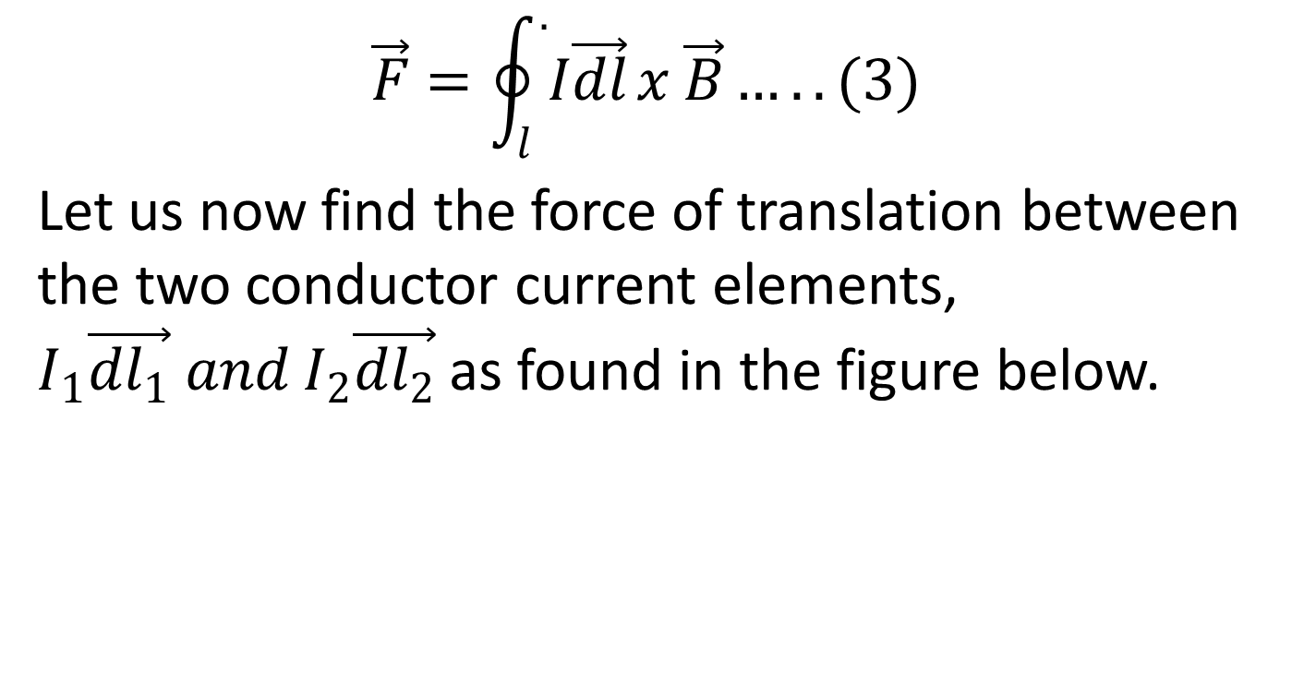
$$\vec{F}=\oint_{l}^{.}{I\vec{dl}}x \vec{B}…..(3)$$
Let us now find the force of translation between the two conductor current elements, $I_{1}\vec{{dl}_{1}} and I_{2}\vec{{dl}_{2}}$ as found in the figure below.

Slide 5
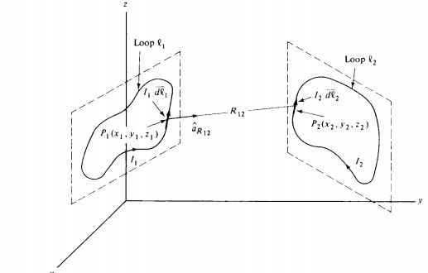

Slide 6
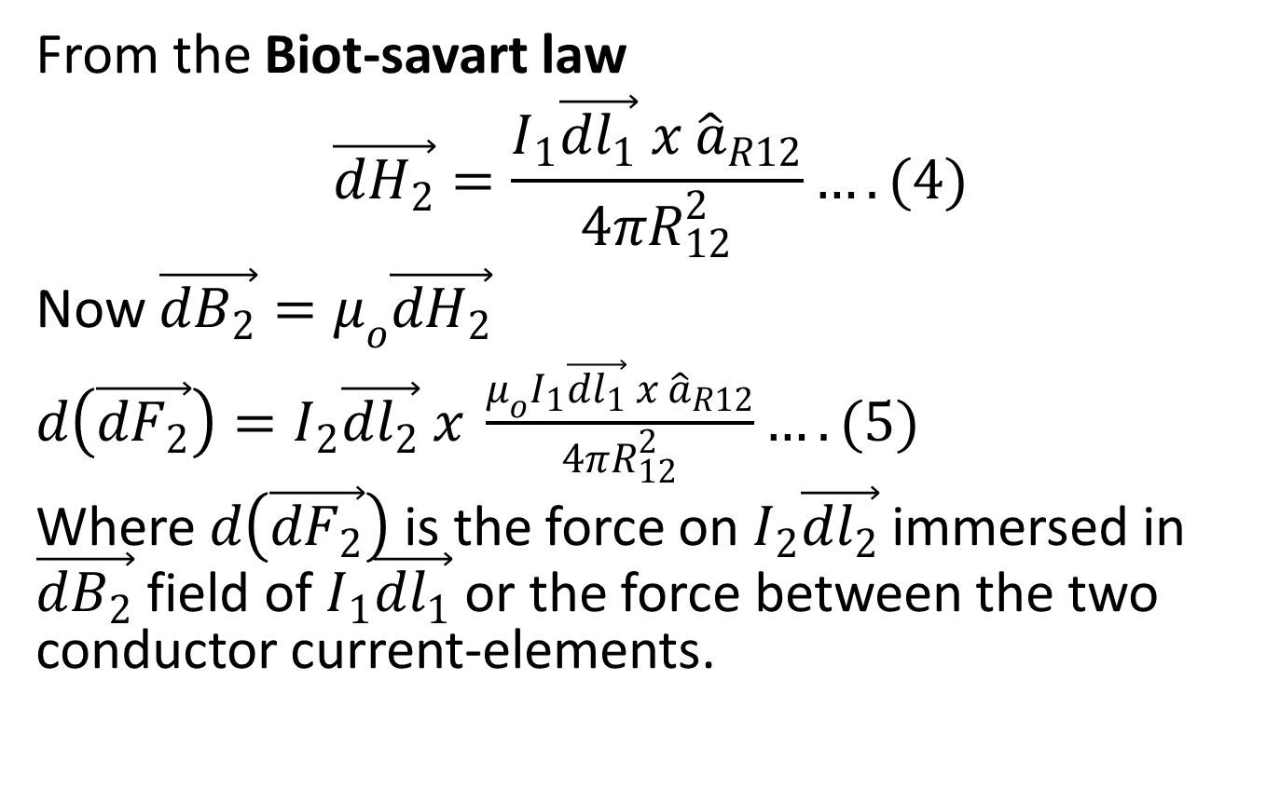
From the Biot-savart law
$$\vec{{dH}_{2}}=\frac{I_{1}\vec{{dl}_{1}} x {\hat{a}}_{R12}}{4πR_{12}^{2}}….(4)$$
Now $\vec{{dB}_{2}}=μ_{o}\vec{{dH}_{2}}$
$d\left(\vec{{dF}_{2}}\right)=I_{2}\vec{{dl}_{2}} x \frac{μ_{o}I_{1}\vec{{dl}_{1}} x {\hat{a}}_{R12}}{4πR_{12}^{2}}….(5)$
Where $d\left(\vec{{dF}_{2}}\right)$ is the force on $I_{2}\vec{{dl}_{2}}$ immersed in $\vec{{dB}_{2}}$ field of $I_{1}\vec{{dl}_{1}}$ or the force between the two conductor current-elements.

Slide 7
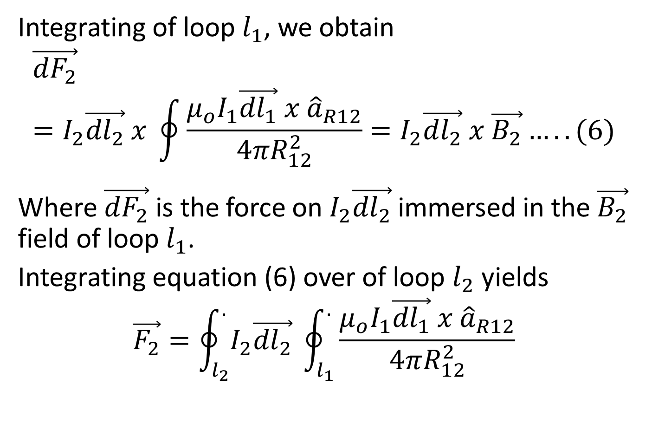
Integrating of loop $l_{1}$, we obtain
$$\vec{{dF}_{2}}=I_{2}\vec{{dl}_{2}} x \oint{\frac{μ_{o}I_{1}\vec{{dl}_{1}} x {\hat{a}}_{R12}}{4πR_{12}^{2}}=I_{2}\vec{{dl}_{2}} x \vec{B_{2}}…..(6)}$$
Where $\vec{{dF}_{2}}$ is the force on $I_{2}\vec{{dl}_{2}}$ immersed in the $\vec{B_{2}}$ field of loop $l_{1}$.
Integrating equation (6) over of loop $l_{2}$ yields
$$\vec{F_{2}}=\oint_{l_{2}}^{.}{I_{2}\vec{{dl}_{2}} }\oint_{l_{1}}^{.}{\frac{μ_{o}I_{1}\vec{{dl}_{1}} x {\hat{a}}_{R12}}{4πR_{12}^{2}}}$$

Slide 8

$$=\frac{μ_{o}I_{1}I_{2}}{4πR_{12}^{2}}\oint_{l_{2}}^{.}{\vec{{dl}_{2}}}\oint_{l_{1}}^{.}{\vec{{dl}_{1}} x {\hat{a}}_{R12}}$$

Slide 9
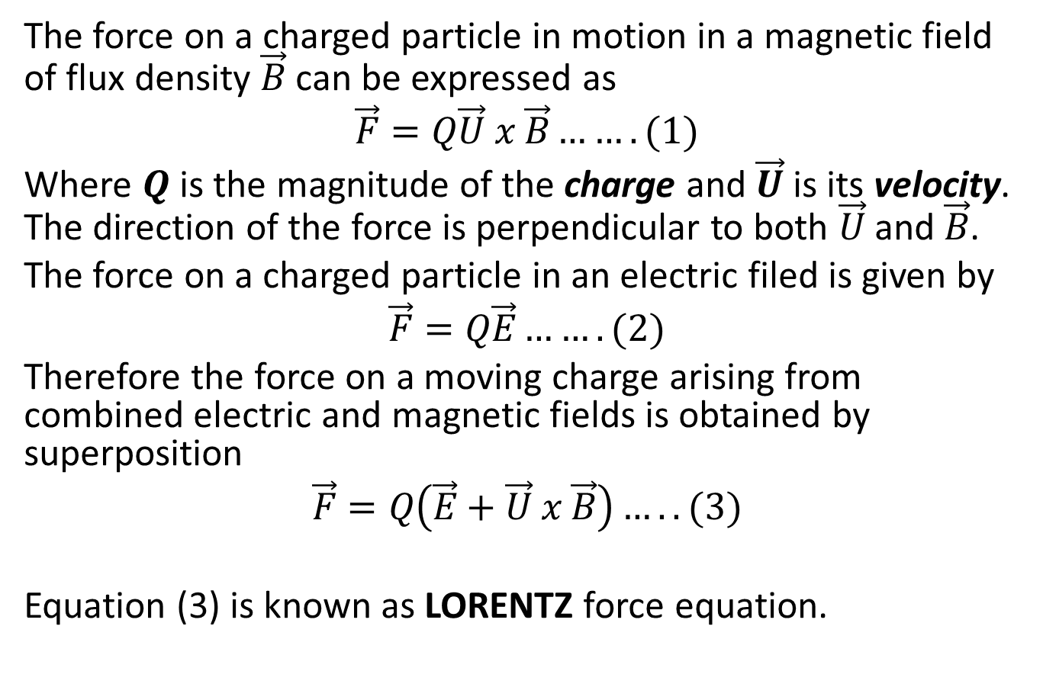
FORCE ON A MOVING CHARGE
The force on a charged particle in motion in a magnetic field of flux density $\vec{B}$ can be expressed as
$$\vec{F}=Q\vec{U} x \vec{B}…….(1)$$
Where $Q$is the magnitude of the charge and $\vec{U}$is its velocity. The direction of the force is perpendicular to both $\vec{U}$and $\vec{B}$.
The force on a charged particle in an electric filed is given by
$$\vec{F}=Q\vec{E}…….(2)$$
Therefore the force on a moving charge arising from combined electric and magnetic fields is obtained by superposition
$$\vec{F}=Q\left(\vec{E}+\vec{U} x \vec{B}\right)…..(3)$$
Equation (3) is known as LORENTZ force equation.

Slide 10
MAGNETIC MATERIALS
Magnetic materials can be classified according to how they behave in the absence of an applied magnetic field. These classification are;
Diamagnetic
Paramagnetic
Ferromagnetic
Anti-ferromagnetic
Ferrimagnetic
Prominent characteristics of magnetic material is magnetic polarization, the alignment of its atomic magnetic dipoles when a magnetic field is applied.

Slide 11
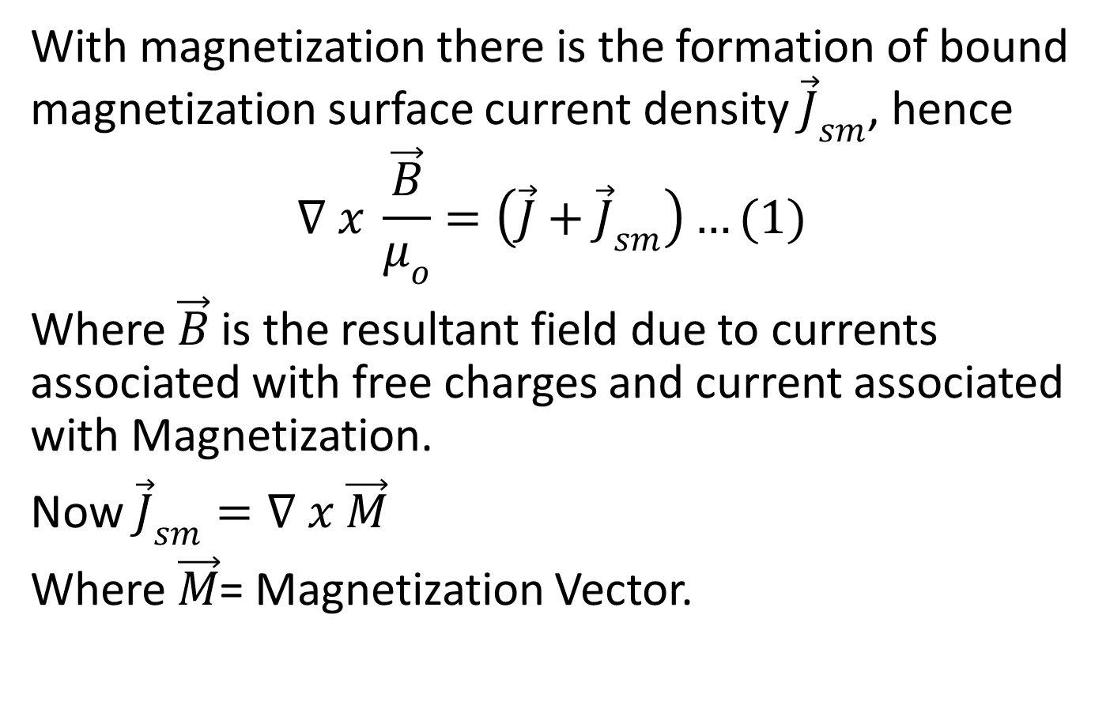
MAGNETIZATION AND PERMEABILITY
With magnetization there is the formation of bound magnetization surface current density ${\vec{J}}_{sm}$, hence
$$∇ x \frac{\vec{B}}{μ_{o}}=\left(\vec{J}+{\vec{J}}_{sm}\right)…(1)$$
Where $\vec{B}$ is the resultant field due to currents associated with free charges and current associated with Magnetization.
Now ${\vec{J}}_{sm}=∇ x \vec{M}$
Where $\vec{M}$= Magnetization Vector.

Slide 12
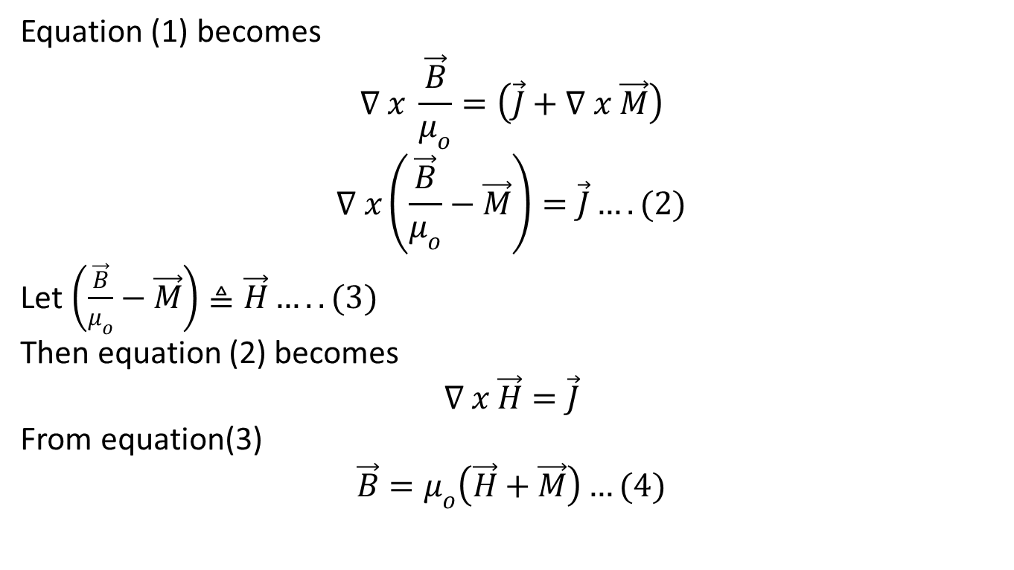
Equation (1) becomes
$$∇ x \frac{\vec{B}}{μ_{o}}=\left(\vec{J}+∇ x \vec{M}\right)$$
$$∇ x\left(\frac{\vec{B}}{μ_{o}}−\vec{M}\right)=\vec{J}….(2)$$
Let $\left(\frac{\vec{B}}{μ_{o}}−\vec{M}\right)≜\vec{H}…..(3)$
Then equation (2) becomes
$$∇ x \vec{H}=\vec{J}$$
From equation(3)
$$\vec{B}=μ_{o}\left(\vec{H}+\vec{M}\right)…(4)$$

Slide 13
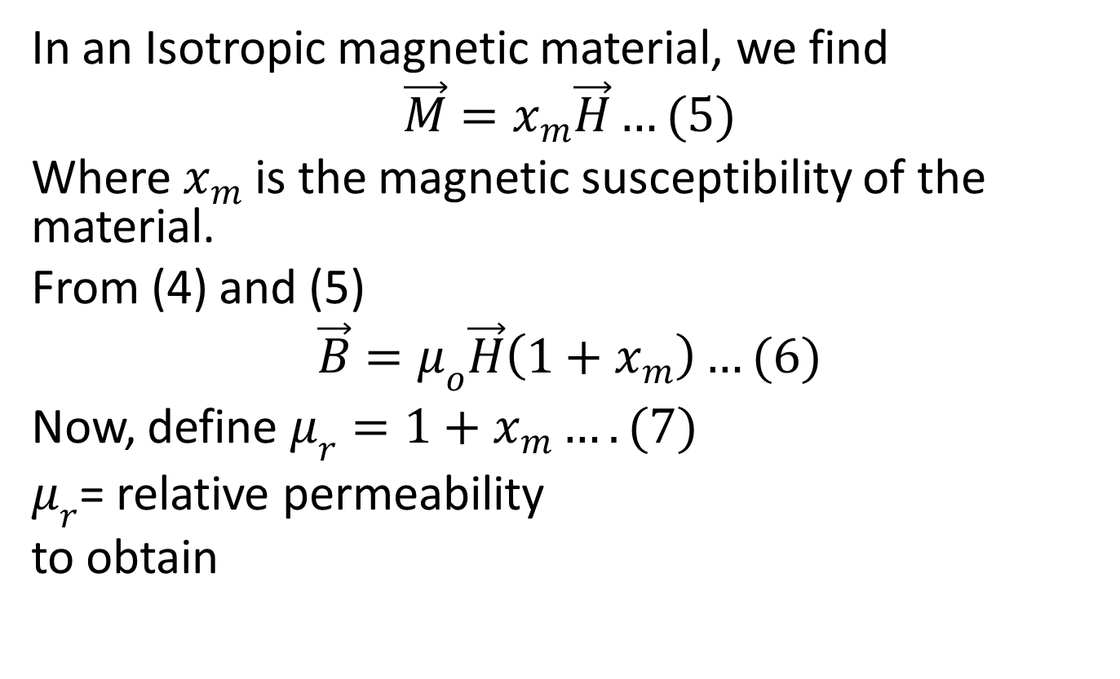
In an Isotropic magnetic material, we find
$$\vec{M}=x_{m}\vec{H}…(5)$$
Where $x_{m}$ is the magnetic susceptibility of the material.
From (4) and (5)
$$\vec{B}=μ_{o}\vec{H}\left(1+x_{m}\right)…(6)$$
Now, define $μ_{r}=1+x_{m}….(7)$
$μ_{r}$= relative permeability
to obtain

Slide 14
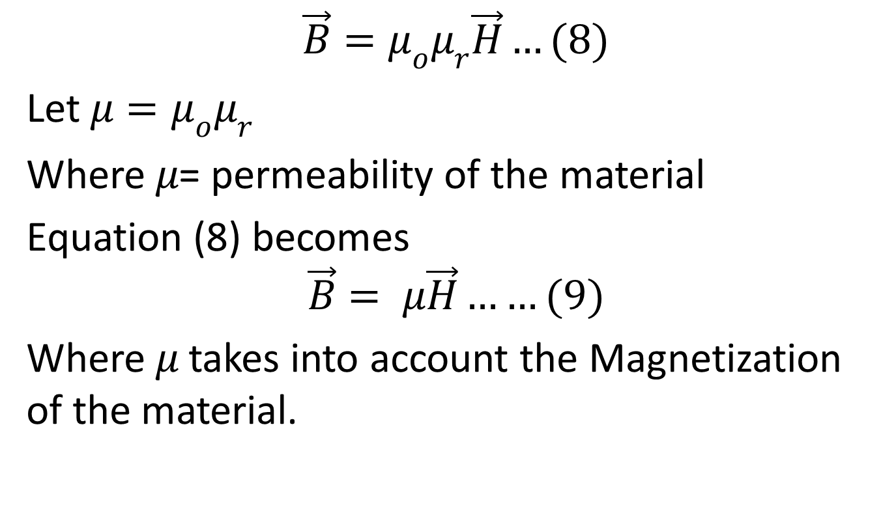
$$\vec{B}=μ_{o}μ_{r}\vec{H}…(8)$$
Let $μ=μ_{o}μ_{r}$
Where $μ$= permeability of the material
Equation (8) becomes
$$\vec{B}= μ\vec{H}……(9)$$
Where $μ$ takes into account the Magnetization of the material.

Slide 15
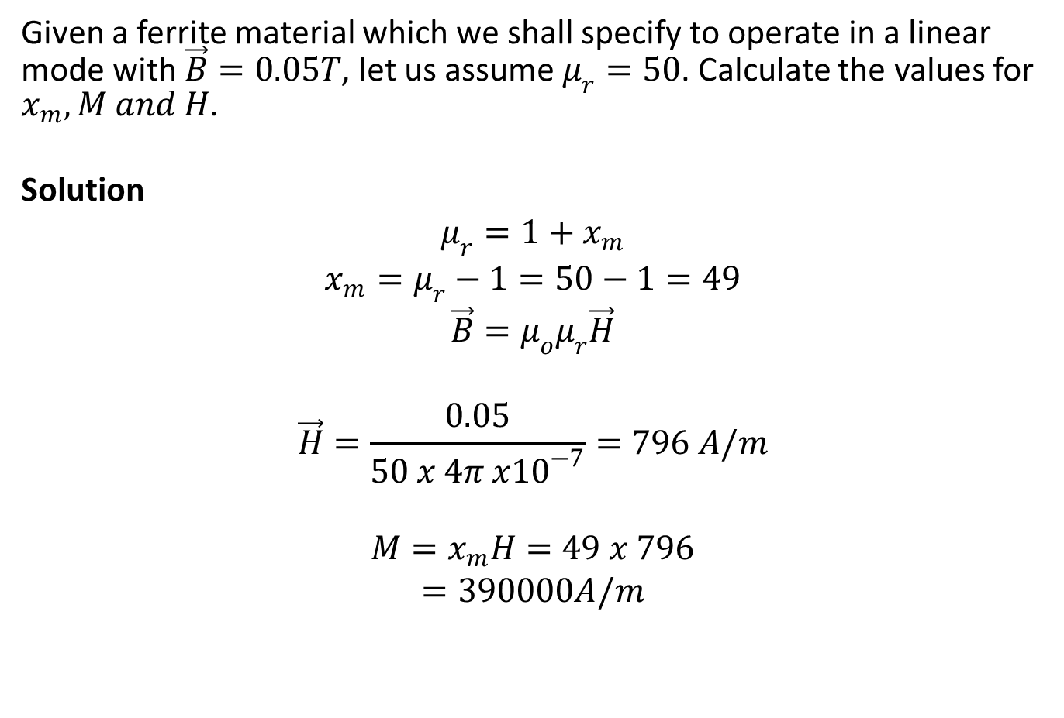
Example
Given a ferrite material which we shall specify to operate in a linear mode with $\vec{B}=0.05T$, let us assume $μ_{r}=50$. Calculate the values for $x_{m}, M and H$.
Solution
$$μ_{r}=1+x_{m}$$
$$x_{m}=μ_{r}−1=50−1=49$$
$$\vec{B}=μ_{o}μ_{r}\vec{H}$$
$$\vec{H}=\frac{0.05}{50 x 4π x{10}^{−7}}=796 A/m$$
$$M=x_{m}H=49 x 796$$
$$=390000A/m$$

Slide 16
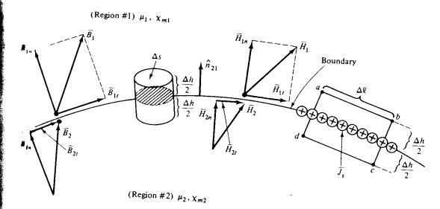
Magnetic Boundary Conditions

Slide 17
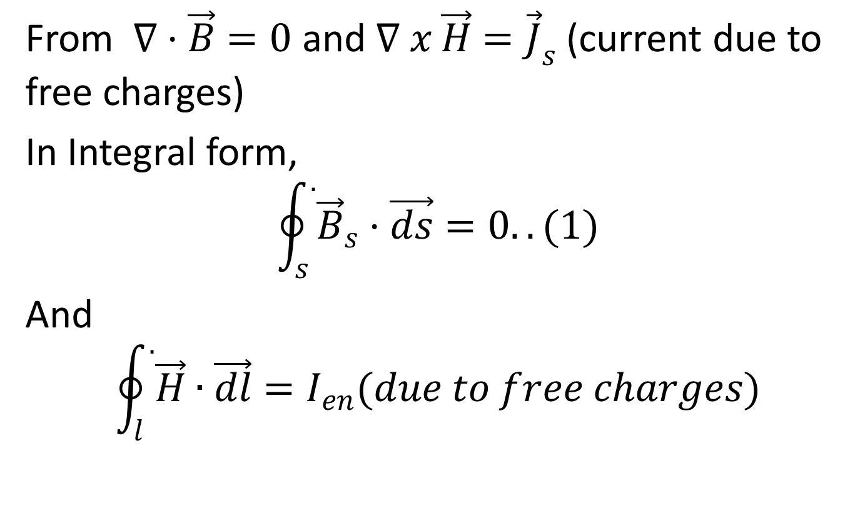
From $∇·\vec{B}=0$ and $∇ x \vec{H}={\vec{J}}_{s}$ (current due to free charges)
In Integral form,
$$\oint_{s}^{.}{{\vec{B}}_{s}·\vec{ds}}=0..(1)$$
And
$$\oint_{l}^{.}{\vec{H}}∙\vec{dl}=I_{en}(due to free charges)$$

Slide 18
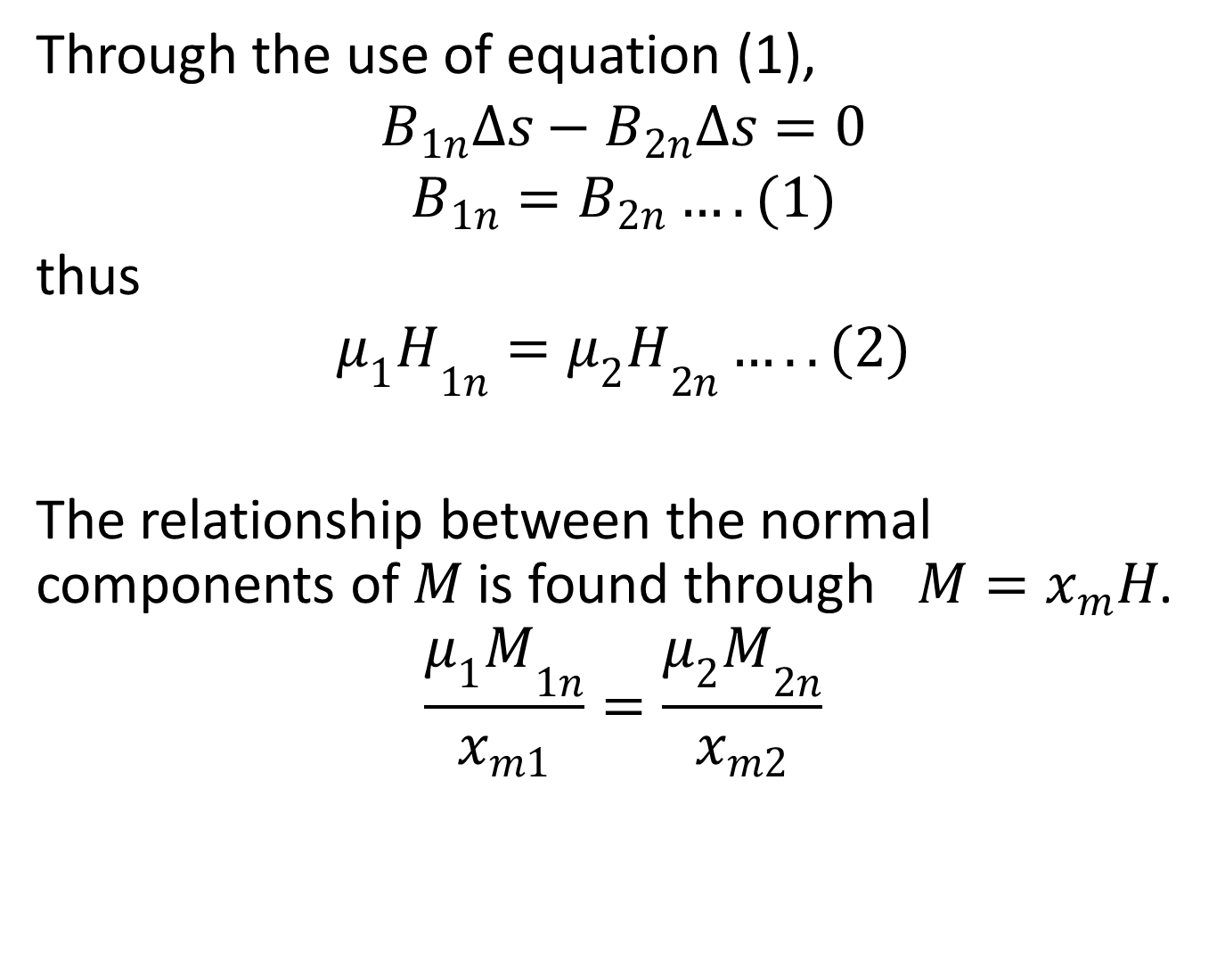
Through the use of equation (1),
$$B_{1n}∆s−B_{2n}∆s=0$$
$$B_{1n}=B_{2n}….(1)$$
thus
$${μ_{1}H}_{1n}={μ_{2}H}_{2n}…..(2)$$
The relationship between the normal components of $M$ is found through $M=x_{m}H$.
$$\frac{{μ_{1}M}_{1n}}{x_{m1}}=\frac{{μ_{2}M}_{2n}}{x_{m2}}$$

Slide 19
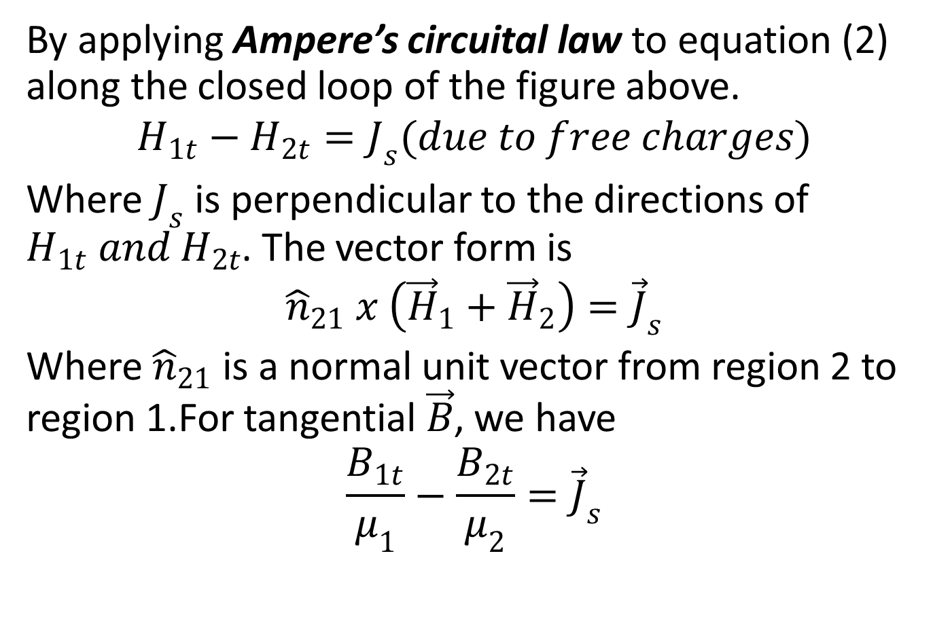
By applying Ampere’s circuital law to equation (2) along the closed loop of the figure above.
$$H_{1t}−H_{2t}=J_{s}(due to free charges)$$
Where $J_{s}$ is perpendicular to the directions of $H_{1t} and H_{2t}$. The vector form is
$${\hat{n}}_{21} x \left({\vec{H}}_{1}+{\vec{H}}_{2}\right)={\vec{J}}_{s}$$
Where ${\hat{n}}_{21}$ is a normal unit vector from region 2 to region 1.For tangential $\vec{B}$, we have
$$\frac{B_{1t}}{μ_{1}}−\frac{B_{2t}}{μ_{2}}={\vec{J}}_{s}$$

Slide 20

And for the magnetization vector
$\frac{M_{1t}}{x_{m1}}−\frac{M_{2t}}{x_{m2}}={\vec{J}}_{s}$

Slide 21
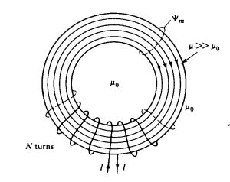
MAGNETIC CIRCUITS

Slide 22
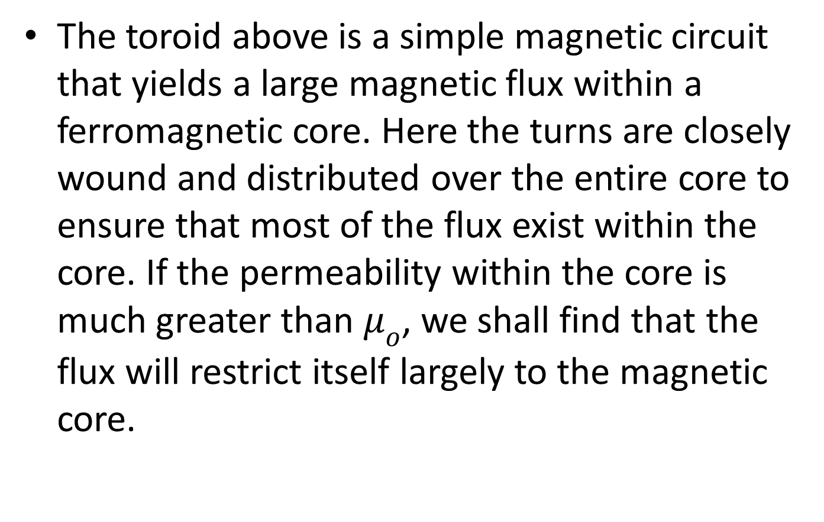
The toroid above is a simple magnetic circuit that yields a large magnetic flux within a ferromagnetic core. Here the turns are closely wound and distributed over the entire core to ensure that most of the flux exist within the core. If the permeability within the core is much greater than $μ_{o}$, we shall find that the flux will restrict itself largely to the magnetic core.

Slide 23
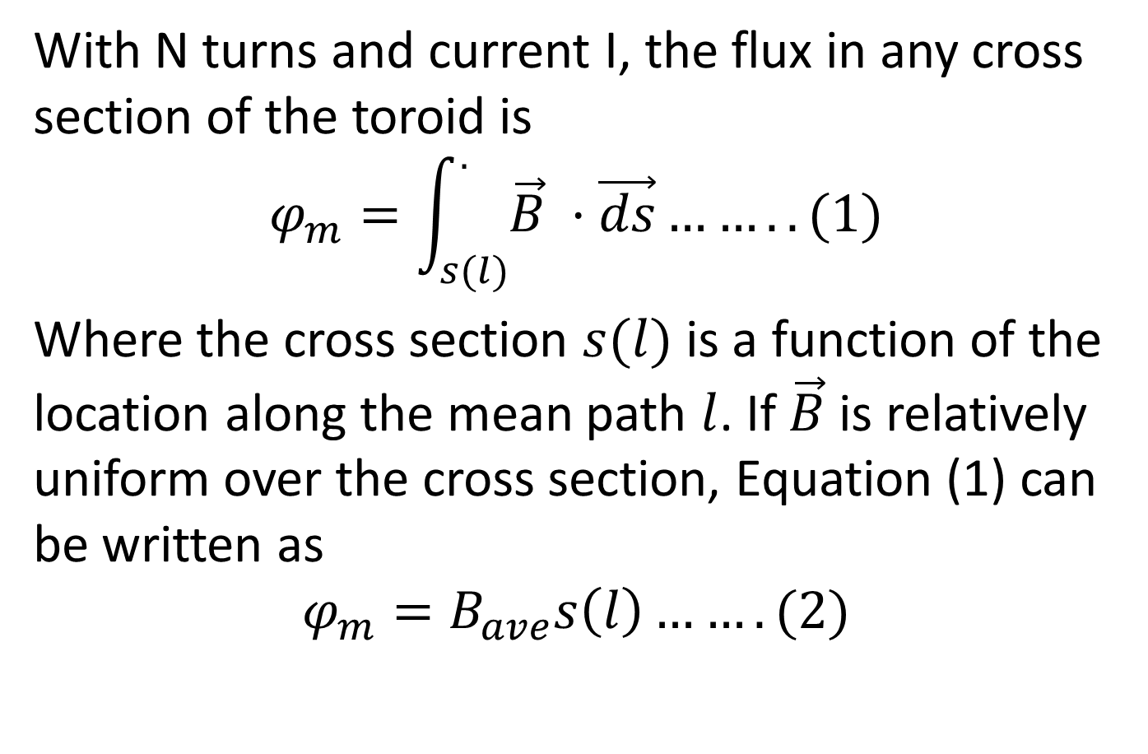
With N turns and current I, the flux in any cross section of the toroid is
$$φ_{m}=\int_{s(l)}^{.}{\vec{B} ·\vec{ds}……..(1)}$$
Where the cross section $s(l)$ is a function of the location along the mean path $l$. If $\vec{B}$ is relatively uniform over the cross section, Equation (1) can be written as
$$φ_{m}=B_{ave}s\left(l\right)…….(2)$$

Slide 24
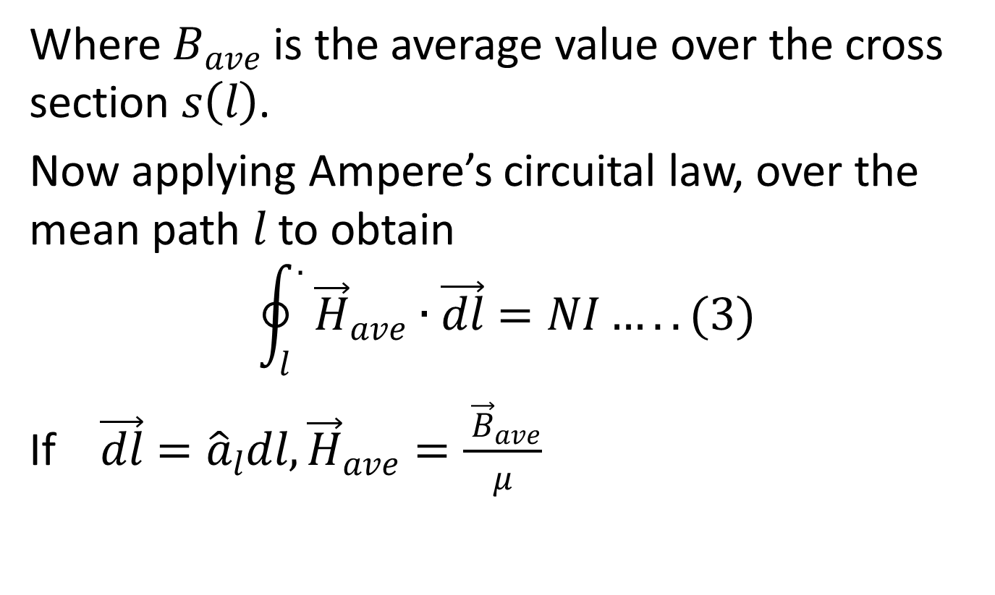
Where $B_{ave}$ is the average value over the cross section $s\left(l\right)$.
Now applying Ampere’s circuital law, over the mean path $l$ to obtain
$$\oint_{l}^{.}{{ \vec{H}}_{ave}}∙\vec{dl}=NI…..(3)$$
If $\vec{dl}={\hat{a}}_{l}dl, {\vec{H}}_{ave}=\frac{{ \vec{B}}_{ave}}{μ}$

Slide 25
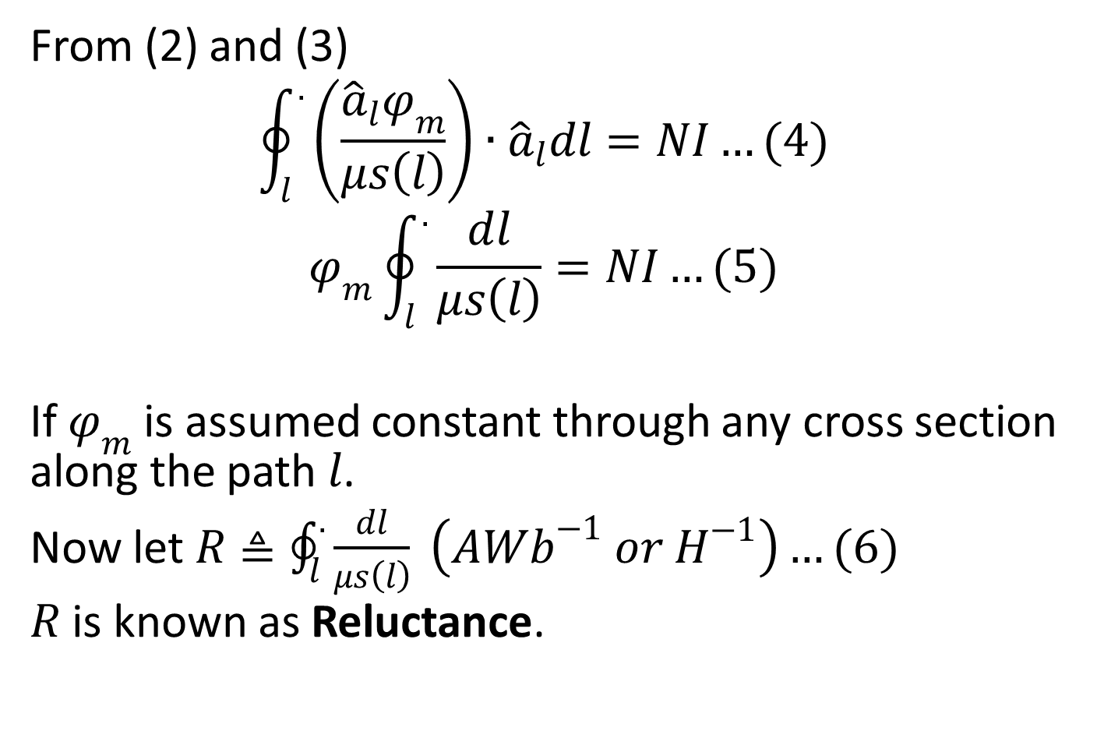
From (2) and (3)
$$\oint_{l}^{.}{\left(\frac{{\hat{a}}_{l}φ_{m}}{μs\left(l\right)}\right)}∙{\hat{a}}_{l}dl=NI…(4)$$
$$φ_{m}\oint_{l}^{.}{\frac{dl}{μs\left(l\right)}}=NI…(5)$$
If $φ_{m}$ is assumed constant through any cross section along the path $l$.
Now let $R≜\oint_{l}^{.}{\frac{dl}{μs\left(l\right)}} \left(AWb^{−1} or H^{−1}\right)…(6)$
$R$ is known as Reluctance.

Slide 26
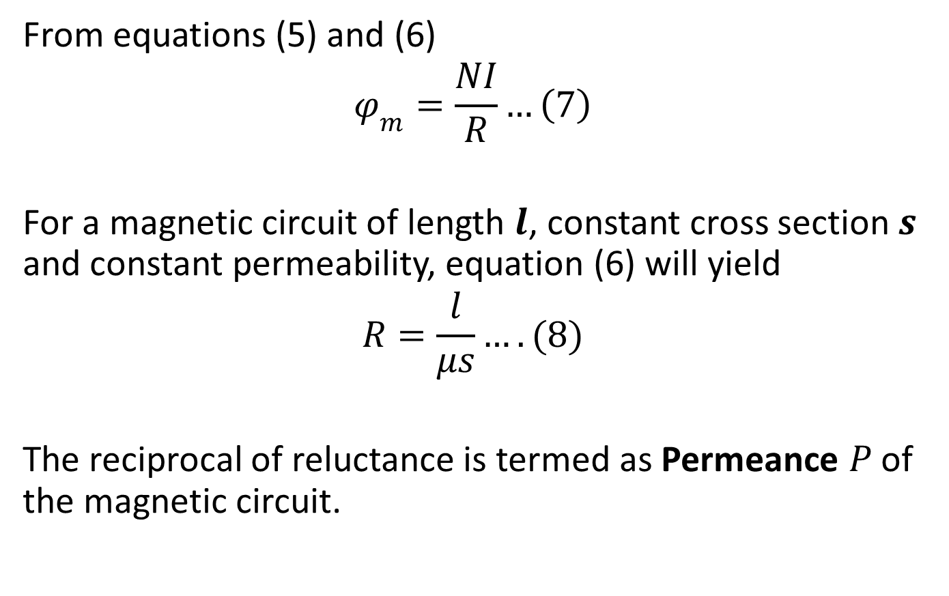
From equations (5) and (6)
$$φ_{m}=\frac{NI}{R}…\left(7\right)$$
For a magnetic circuit of length $l$, constant cross section $s$ and constant permeability, equation (6) will yield
$$R=\frac{l}{μs}….(8)$$
The reciprocal of reluctance is termed as Permeance $P$ of the magnetic circuit.

Slide 27
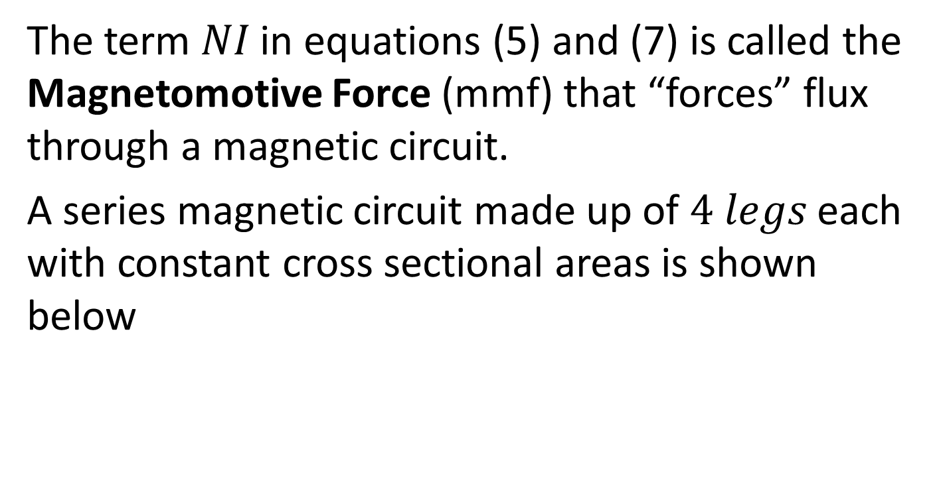
The term $NI$ in equations (5) and (7) is called the Magnetomotive Force (mmf) that “forces” flux through a magnetic circuit.
A series magnetic circuit made up of $4 legs$ each with constant cross sectional areas is shown below

Slide 28
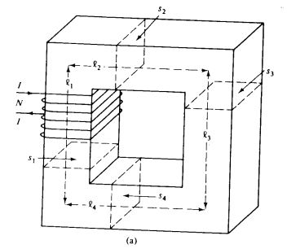
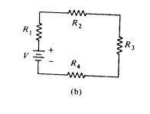

Slide 29
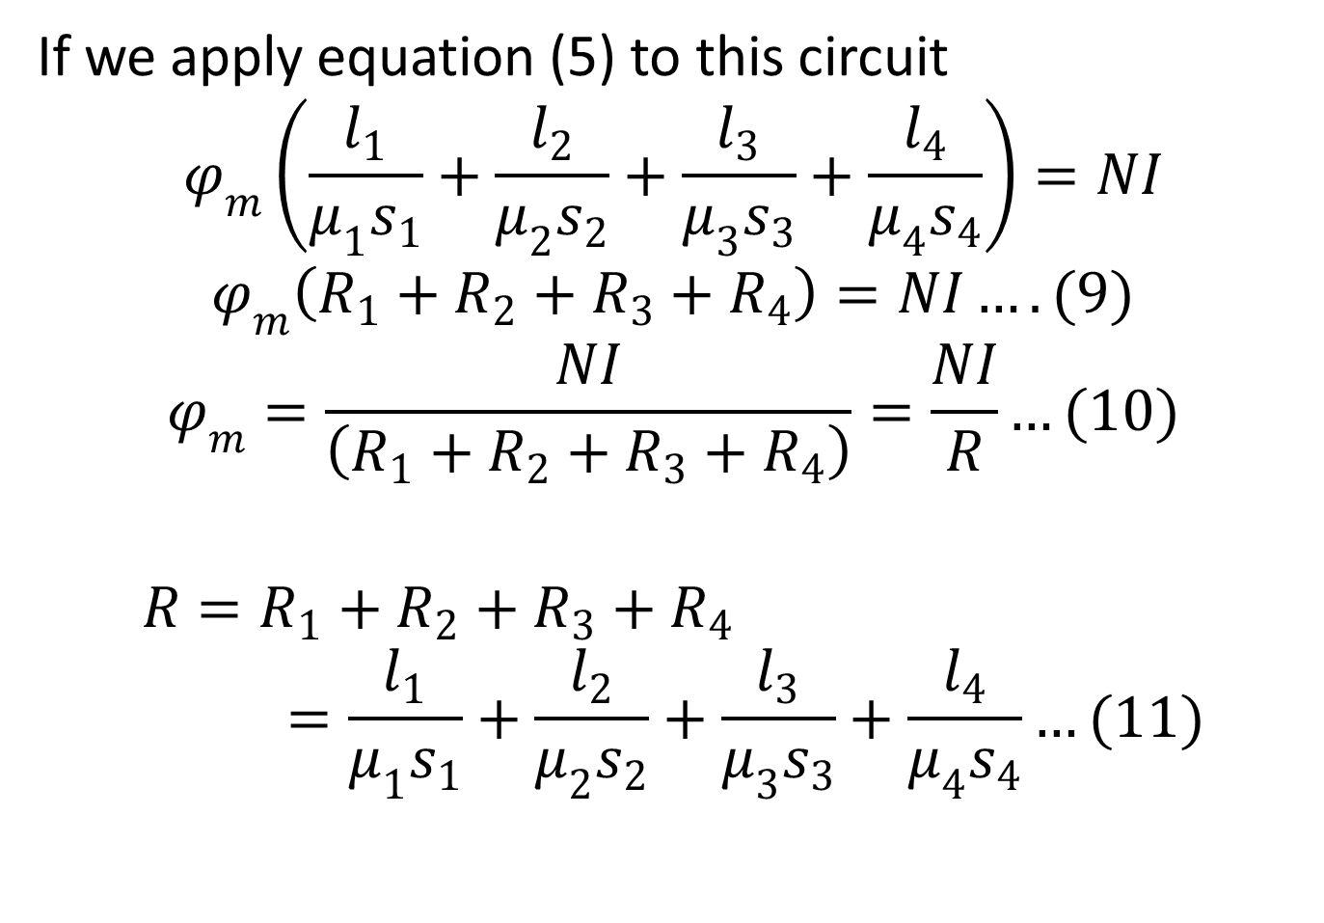
If we apply equation (5) to this circuit
$$φ_{m}\left(\frac{l_{1}}{μ_{1}s_{1}}+\frac{l_{2}}{μ_{2}s_{2}}+\frac{l_{3}}{μ_{3}s_{3}}+\frac{l_{4}}{μ_{4}s_{4}}\right)=NI$$
$$φ_{m}\left(R_{1}+R_{2}+R_{3}+R_{4}\right)=NI….(9)$$
$$φ_{m}=\frac{NI}{\left(R_{1}+R_{2}+R_{3}+R_{4}\right)}=\frac{NI}{R}…(10)$$
$$R=R_{1}+R_{2}+R_{3}+R_{4}=\frac{l_{1}}{μ_{1}s_{1}}+\frac{l_{2}}{μ_{2}s_{2}}+\frac{l_{3}}{μ_{3}s_{3}}+\frac{l_{4}}{μ_{4}s_{4}}…(11)$$

Slide 30
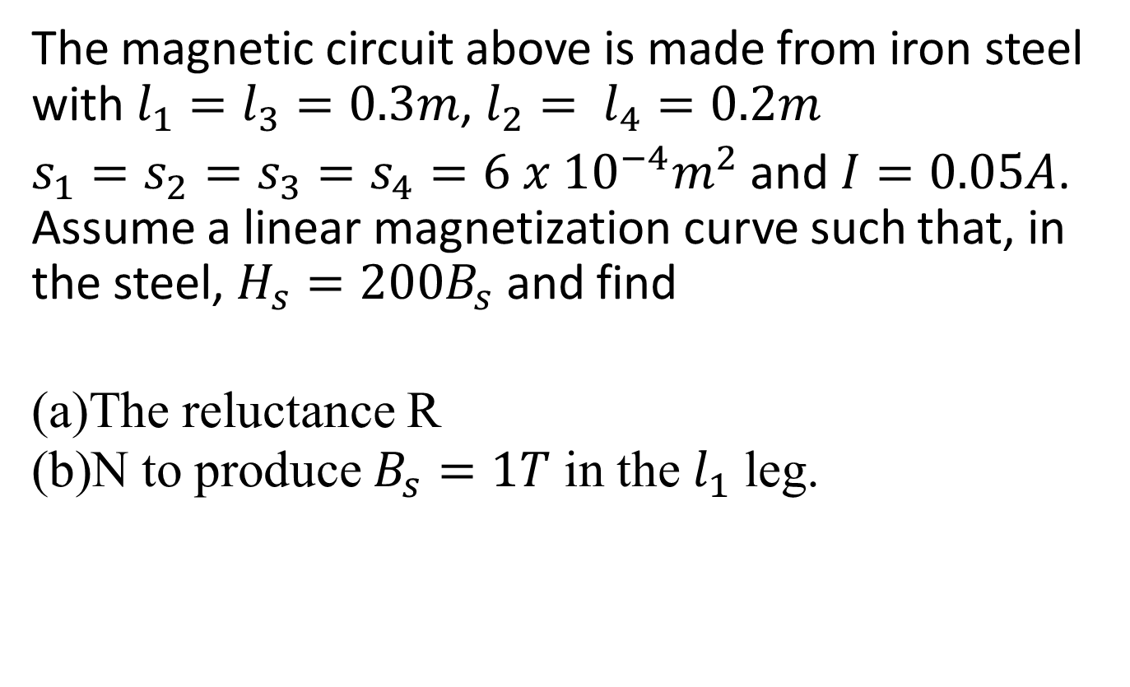
Example
The magnetic circuit above is made from iron steel with $l_{1}=l_{3}=0.3m$, $l_{2}= l_{4}=0.2m$
$s_{1}=s_{2}=s_{3}=s_{4}=6 x {10}^{−4}m^{2}$ and $I=0.05A$. Assume a linear magnetization curve such that, in the steel, $H_{s}=200B_{s}$ and find
The reluctance R
N to produce $B_{s}=1T$ in the $l_{1}$ leg.

Slide 31
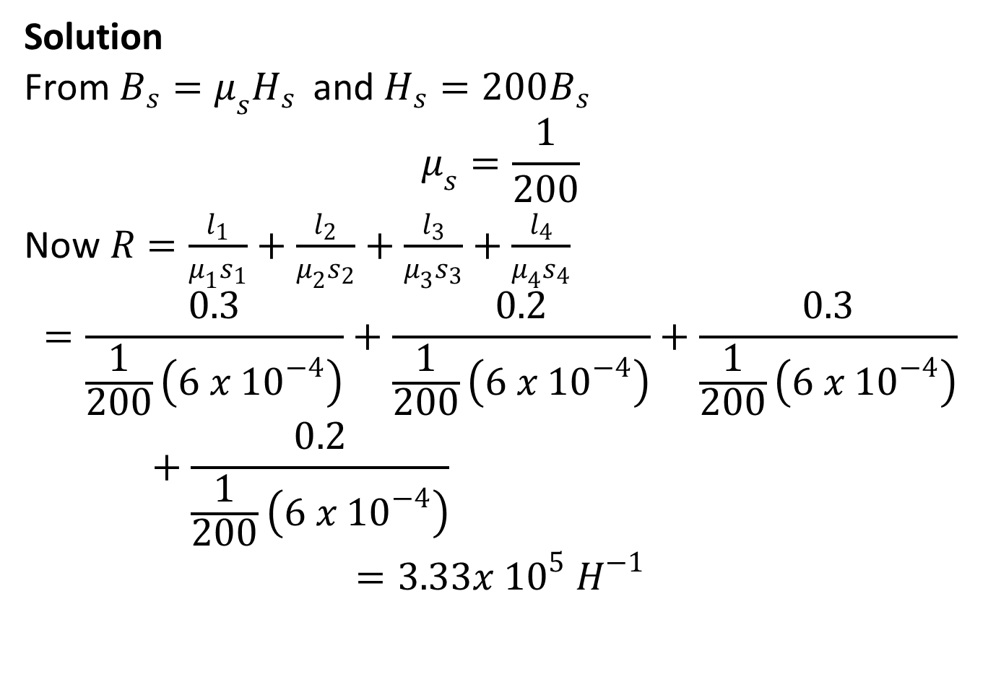
Solution
From $B_{s}=μ_{s}H_{s }$ and $H_{s}=200B_{s}$
$$μ_{s}=\frac{1}{200}$$
Now $R=\frac{l_{1}}{μ_{1}s_{1}}+\frac{l_{2}}{μ_{2}s_{2}}+\frac{l_{3}}{μ_{3}s_{3}}+\frac{l_{4}}{μ_{4}s_{4}}$
$$=\frac{0.3}{\frac{1}{200}\left(6 x {10}^{−4}\right)}+\frac{0.2}{\frac{1}{200}\left(6 x {10}^{−4}\right)}+\frac{0.3}{\frac{1}{200}\left(6 x {10}^{−4}\right)}+\frac{0.2}{\frac{1}{200}\left(6 x {10}^{−4}\right)}$$
$$=3.33x {10}^{5} H^{−1}$$

Slide 32
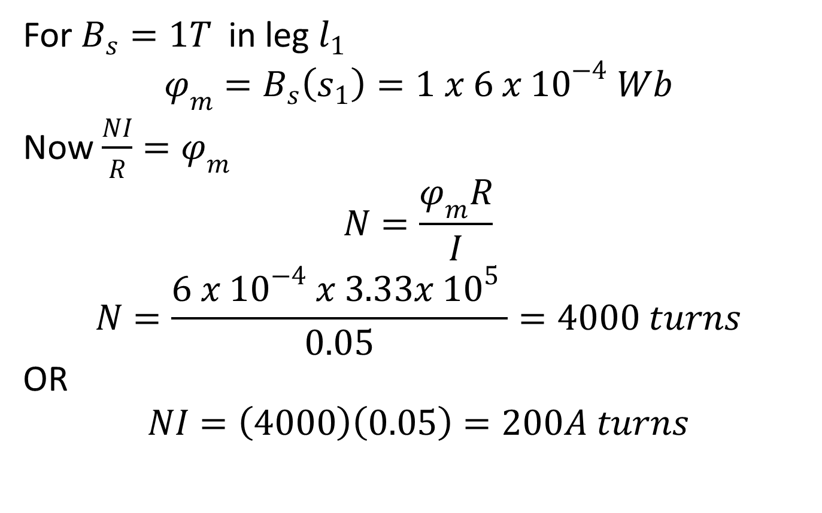
For $B_{s}=1T$in leg $l_{1}$
$$φ_{m}=B_{s}\left(s_{1}\right)=1 x 6 x {10}^{−4} Wb$$
Now $\frac{NI}{R}=φ_{m}$
$$N=\frac{φ_{m}R}{I}$$
$$N=\frac{6 x {10}^{−4} x 3.33x {10}^{5} }{0.05}=4000 turns$$
OR
$$NI=\left(4000\right)\left(0.05\right)=200A turns$$

Slide 33
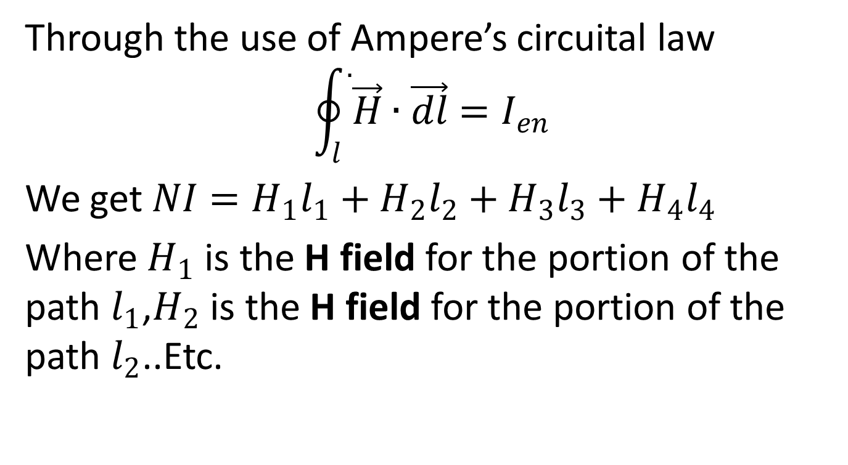
Through the use of Ampere’s circuital law
$$\oint_{l}^{.}{\vec{H}}∙\vec{dl}=I_{en}$$
We get $NI=H_{1}l_{1}+H_{2}l_{2}+H_{3}l_{3}+H_{4}l_{4}$
Where $H_{1}$ is the H field for the portion of the path $l_{1}$,$H_{2}$ is the H field for the portion of the path $l_{2}$..Etc.

Slide 34
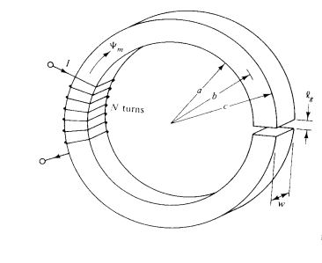
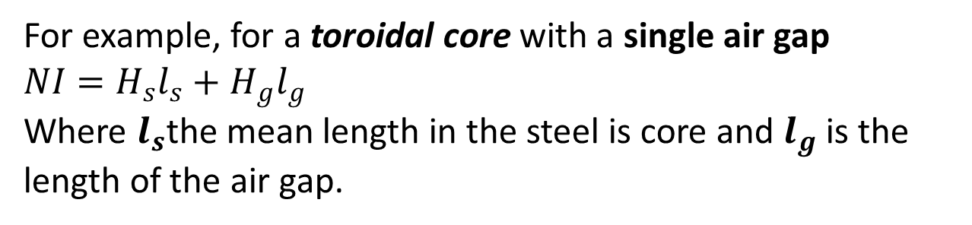
For example, for a toroidal core with a single air gap $NI=H_{s}l_{s}+H_{g}l_{g}$
Where $l_{s}$the mean length in the steel is core and $l_{g}$ is the length of the air gap.

Slide 35
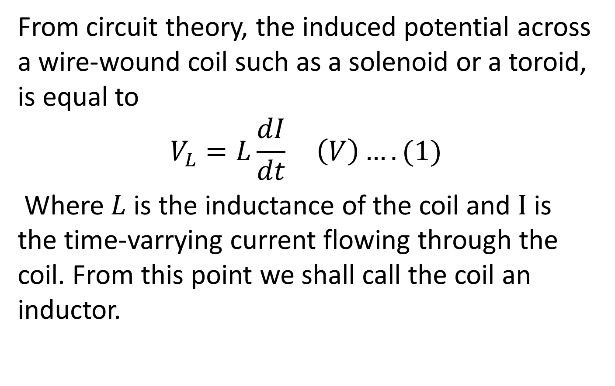
Self-Inductance and Mutual Inductance
From circuit theory, the induced potential across a wire-wound coil such as a solenoid or a toroid, is equal to
$$V_{L}=L\frac{dI}{dt} \left(V\right)….(1)$$
Where $L$ is the inductance of the coil and $I$ is the time-varrying current flowing through the coil. From this point we shall call the coil an inductor.

Slide 36
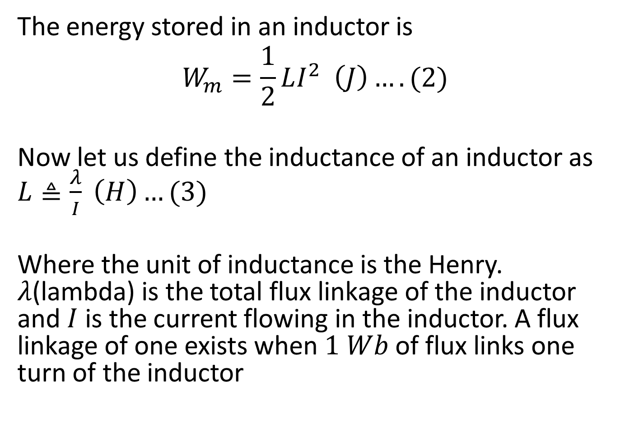
The energy stored in an inductor is
$$W_{m}=\frac{1}{2}LI^{2} \left(J\right)….(2)$$
Now let us define the inductance of an inductor as $L≜\frac{λ}{I} \left(H\right)…(3)$
Where the unit of inductance is the Henry. $λ$(lambda) is the total flux linkage of the inductor and $I$ is the current flowing in the inductor. A flux linkage of one exists when $1 Wb$ of flux links one turn of the inductor

Slide 37
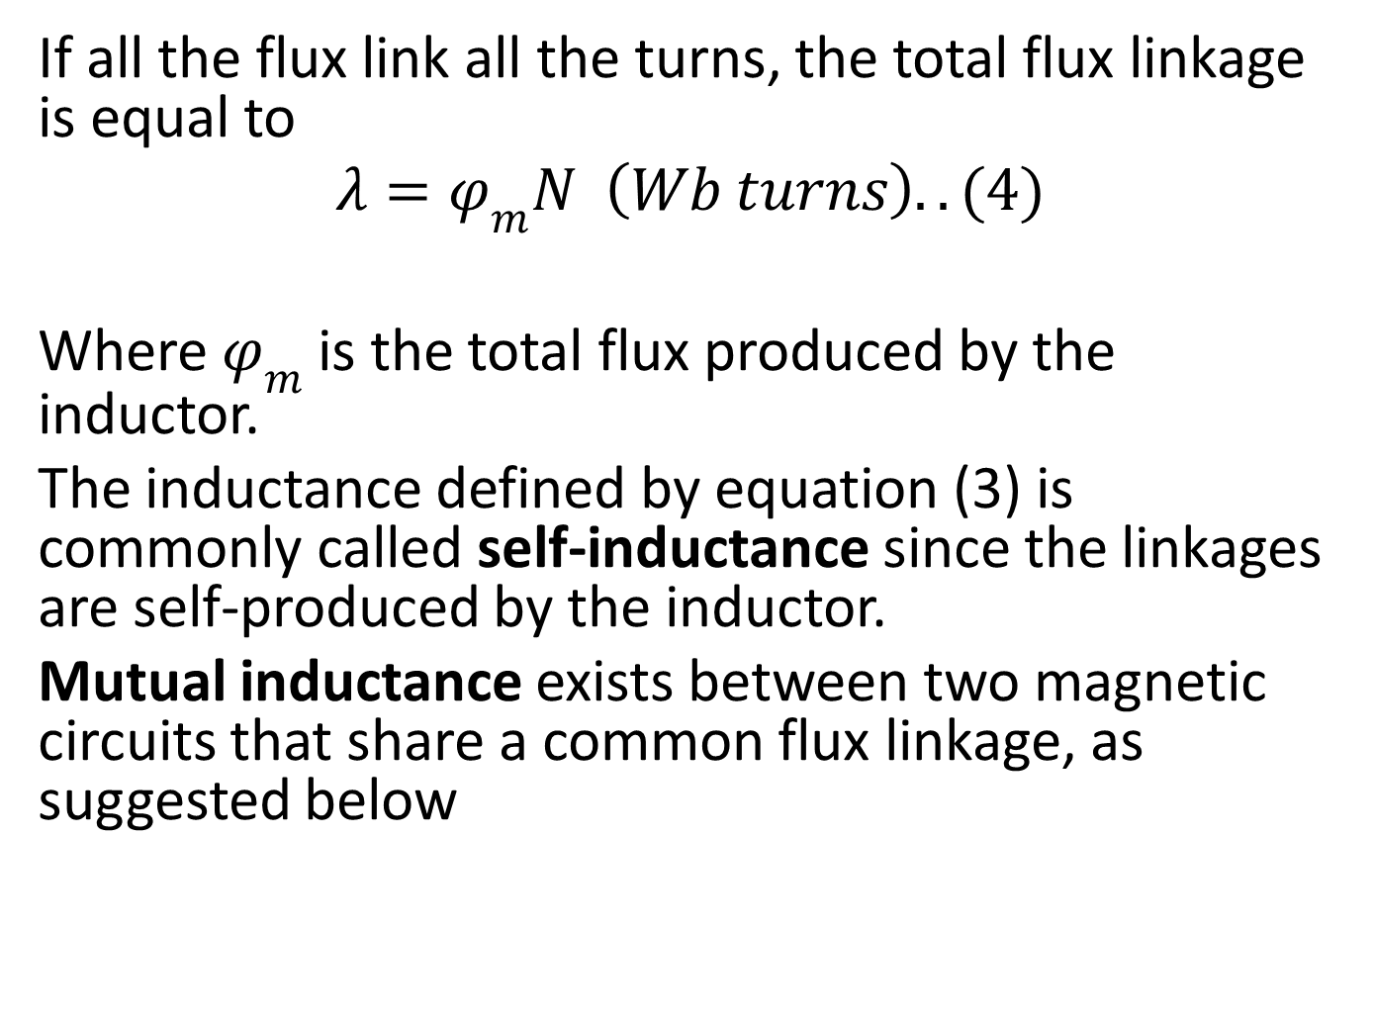
If all the flux link all the turns, the total flux linkage is equal to
$$λ=φ_{m}N \left(Wb turns\right)..(4)$$
Where $φ_{m}$ is the total flux produced by the inductor.
The inductance defined by equation (3) is commonly called self-inductance since the linkages are self-produced by the inductor.
Mutual inductance exists between two magnetic circuits that share a common flux linkage, as suggested below

Slide 38
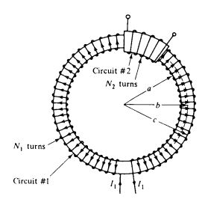
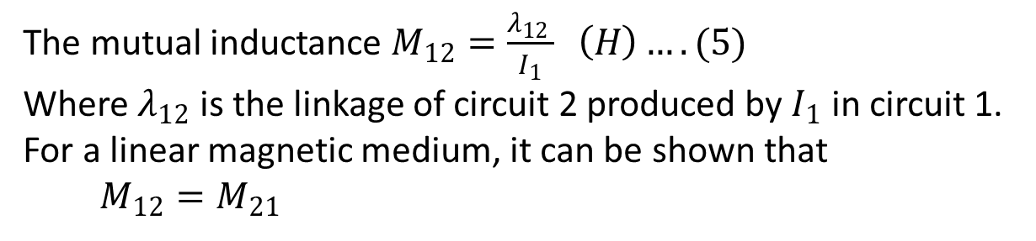
The mutual inductance $M_{12}=\frac{λ_{12} }{I_{1}} \left(H\right)….(5)$
Where $λ_{12}$ is the linkage of circuit 2 produced by $I_{1}$ in circuit 1. For a linear magnetic medium, it can be shown that $M_{12}=M_{21}$

Slide 39
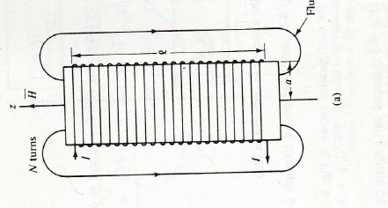
Example
Obtain an expression for the self inductance of the long solenoid shown below

Slide 40
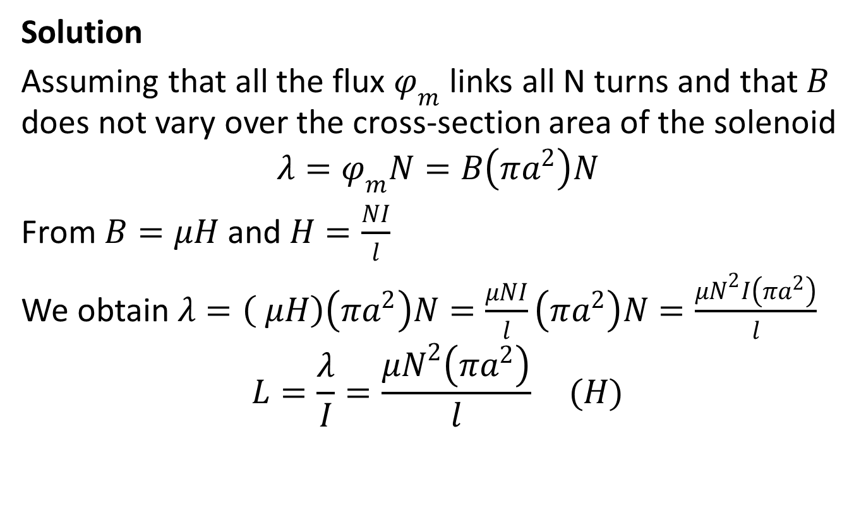
Solution
Assuming that all the flux $φ_{m}$ links all N turns and that $B$ does not vary over the cross-section area of the solenoid
$$λ=φ_{m}N=B\left(πa^{2}\right)N$$
From $B=μH$ and $H=\frac{NI}{l}$
We obtain $λ=\left( μH\right)\left(πa^{2}\right)N=\frac{μNI}{l}\left(πa^{2}\right)N=\frac{μN^{2}I\left(πa^{2}\right)}{l}$
$$L=\frac{λ}{I}=\frac{μN^{2}\left(πa^{2}\right)}{l} (H)$$

Slide 41
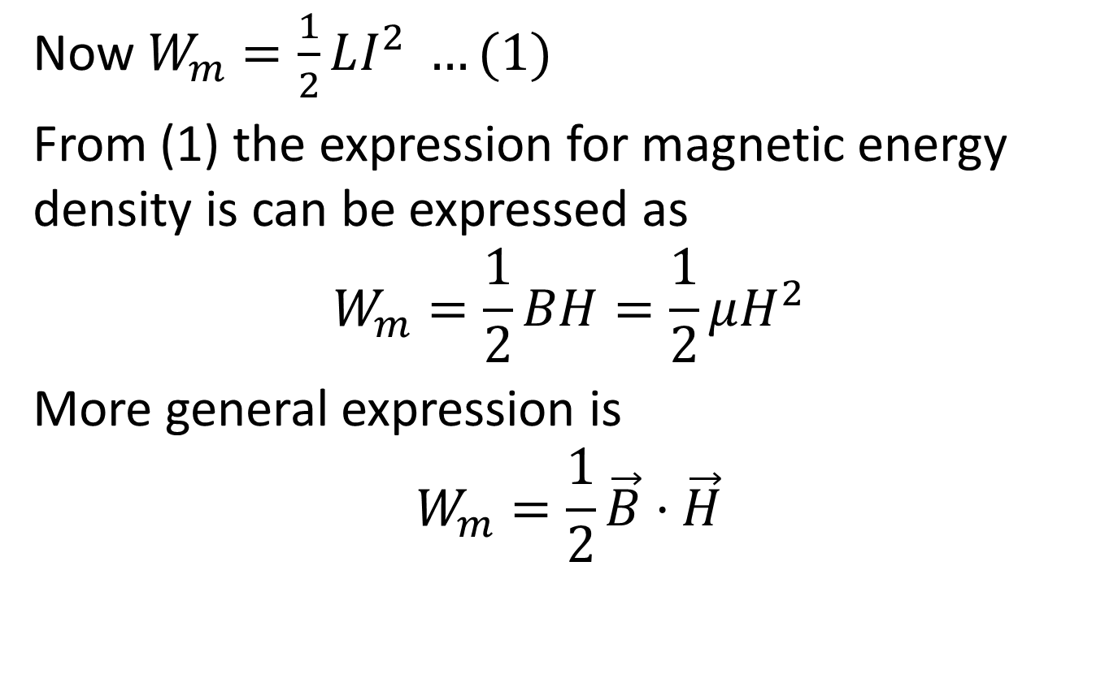
Magnetic Energy
Now $W_{m}=\frac{1}{2}LI^{2} …(1)$
From (1) the expression for magnetic energy density is can be expressed as
$$W_{m}=\frac{1}{2}BH=\frac{1}{2}μH^{2}$$
More general expression is
$$W_{m}=\frac{1}{2}\vec{B}·\vec{H}$$

